Slide 1
Predicting the Severity of Automobile Accidents
Daniel T. Pawlak
September 20, 2020

Slide 2
Introduction
The Business Problem: The focus of this project is the development of a model that can predict the severity of traffic accidents, given weather and road conditions. For this project, severity is one of two categories: either property damage or injury.
Key Stakeholders: The immediate stakeholders of the project are public safety officials hoping to warn drivers of the potential severity of an accident to get them to drive more safely or change their travel plans.

Slide 3
Data
More than 150k observations and many attributes
Weather, Road, Light conditions
Speeding, Distracted, Under-the-Influence
Person, Pedestrian, and Cycle Counts
Data preparation
Handled missing data
Re-structured some attributes:
Example: Weather as a categorical attribute re-structured using indicator variables to correlate each separate weather condition with the severity of an accident
Original dataset unbalanced with regards to the labeled observation. The dataset was balanced to remove a source of bias in the predictive model.
Shared dataset
Compiled by the Seattle DoT, Traffic Management Division, Traffic Records Group
All collisions provided by SPD and recorded by Traffic Records
Timeframe: 2004 - 2020
A more detailed description of the data may be found at:
https://s3.us.cloud-object-storage.appdomain.cloud/cf-courses-data/CognitiveClass/DP0701EN/version-2/Metadata.pdf

Slide 4
Methodology
Data shape. The original dataset has 194,673 rows with 38 columns.
Attributes. Of the 38 columns, some are explicitly mentioned in the project, such as severity code, weather, road condition, and light condition. Other factors likely to be predictive of injury or not include human conditions, such as inattention (distracted driver), under-the-influence, or speeding. Also, attributes that specify the number of people involved in an accident, number of pedestrians, and number of cyclists seem likely to be correlated with likelihood of injury. Other attributes are merely descriptive and therefore unlikely to add any predictive value.
Data Types. Although there are some floats and int variables, many of the attributes are of type object. Of the attributes to be used for the development of the predictive model, the object variables were generally converted to int, since they were mainly 1’s and 0’s.
Missing Values. There were many missing values indicated by nan. Some of these were eliminated by deleting an entire row, such as if one of the key variables were missing. Other nan’s were replaced by appropriate values. This was especially necessary when using indicator variables to convert from categorical attributes.
Unique Values. Identifying the unique values of the attributes helped to understand which variables were categorical and which were numerical.

Slide 5
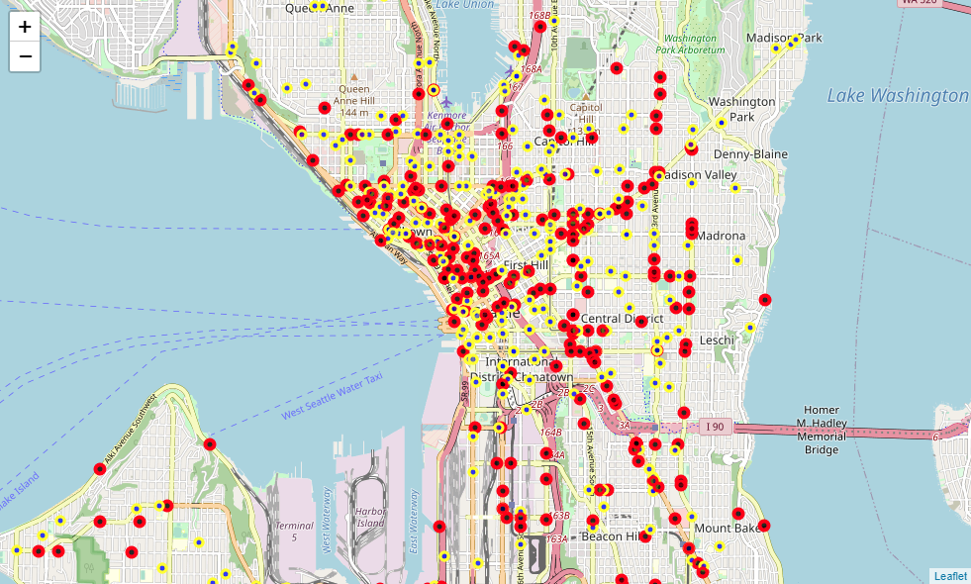
Sample of Accidents plotted by location

Slide 6
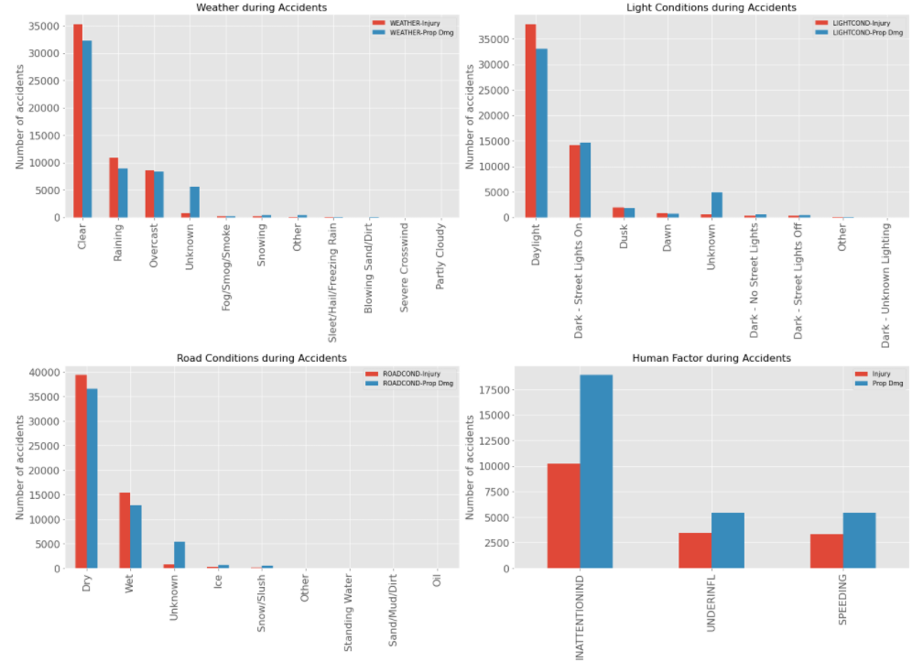
Key Attributes grouped by Severity

Slide 7
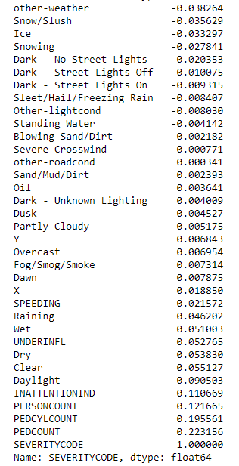
Pearson Correlations

Slide 8
Machine Learning Algorithms
SVM was used because SVM works by mapping data to a high-dimensional feature space so that data points can be categorized, even when the data are not otherwise linearly separable. That way characteristics of new data can be used to predict the group to which a new record should belong. The SVM model was also run with four different kernels (linear, rbf, poly, and sigmoid) to determine which provided the most accurate results.
Decision Tree was also used because the goal of a decision tree is to create a model that predicts the value of a target variable by learning simple decision rules inferred from the data features. If a given situation is observable in a model, the explanation for the condition is easily explained by Boolean logic.
For each model algorithm the model was trained with a balanced dataset with 56,013 observations (That’s how many Severity = Injury observations there were after processing), and tested with the full unbalanced dataset.
Of the full balanced dataset, 20% (22,405 observations) was used for train/test to avoid overtraining the model.
Of the train/test dataset 20% (4481 observations) was used for test.
For final model evaluation, the full unbalanced dataset (184,167 observations) was used as the test dataset.

Slide 9
Results
SVM: Most Accurate kernel = rbf
Based on combined f1 and Jaccard scores for balanced and full unbalanced data
SVM | Dataset | F1 Score | Jaccard Score
linear | Balanced Sample | .638 | .402
 | Full Unbalanced | .681 | .304
rbf | Balanced Sample | .688 | .530
 | Full Unbalanced | .644 | .362
poly | Balanced Sample | .624 | .385
 | Full Unbalanced | .683 | .309
sigmoid | Balanced Sample | .468 | .259
 | Full Unbalanced | .522 | .180

Slide 10
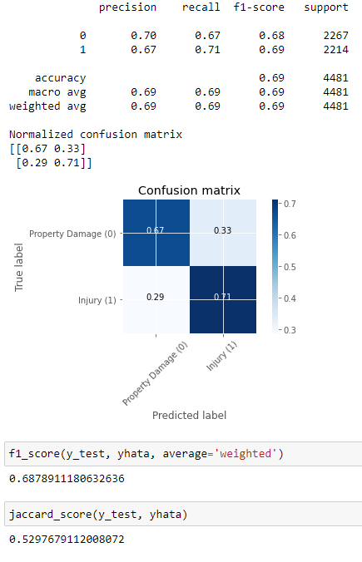
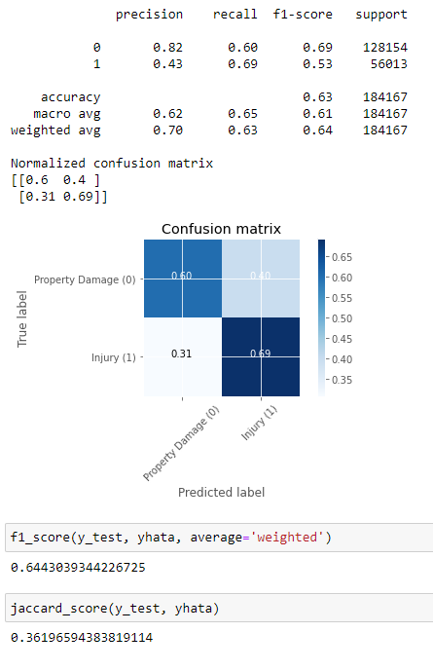
Results
rbf kernel also predicted the best combination of:
highest true positives
lowest false negatives
Svm kernel=rbf, df_bal, limit=22405
Svm kernel=rbf, df, limit=full unbalanced set

Slide 11
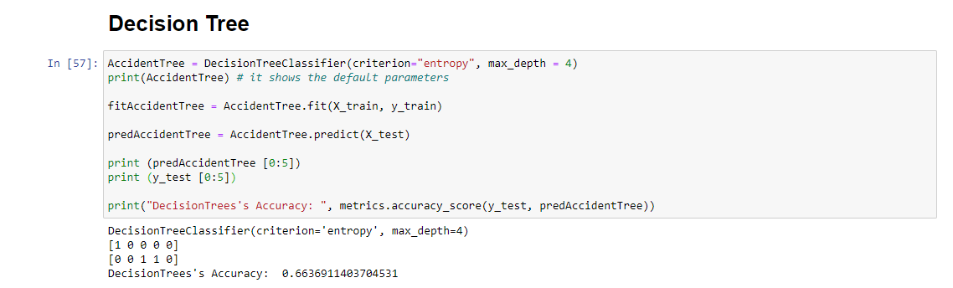
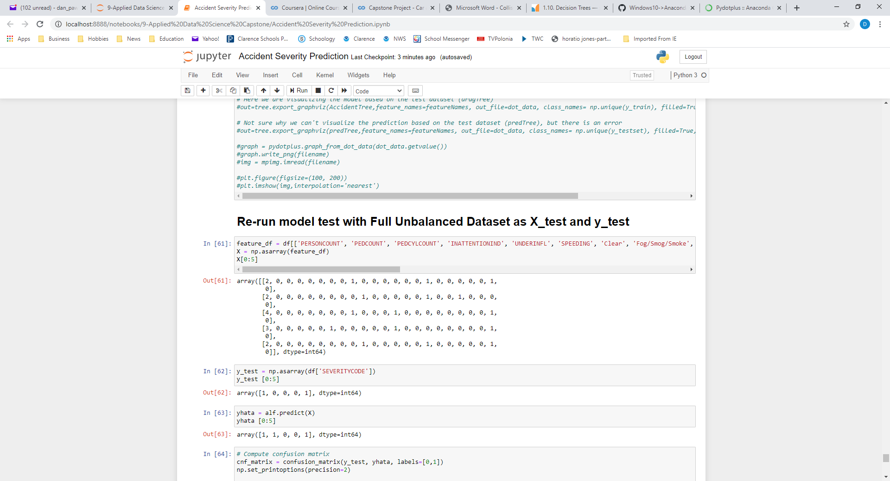
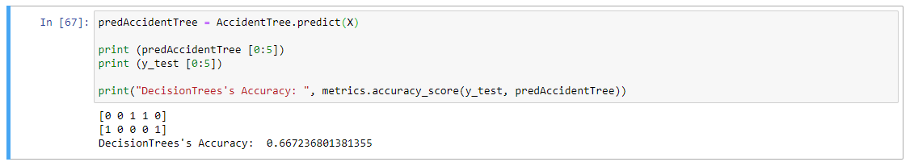
Results
Decision Tree model was also successfully run with comparable accuracy
Technical difficulties prevented visualization of the Decision Tree

Slide 12
Discussion
Bad weather variables didn’t have as strong a correlation with injury as I imagined, especially snow, ice, and weather limiting visibility. The correlation might be strengthened by combining some attributes that reduce visibility (such as fog and darkness) or create slippery conditions (such as rain, ice, snow, and slush).
This model development did not include accident location as predictive variables, although accidents occurring at intersections may have a greater likelihood of injury. This is an opportunity for further testing and potentially increased model accuracy.
This model also did not consider the time of day or day of week of an accident, although those things may also add predictive value. More accidents may occur at morning or evening rush hour when the roads are nearer to capacity, or may occur later at night when people are more likely to be tired. Weekends versus weekdays may also be important. These considerations are an opportunity for possible model improvement.
Although the Decision Tree model was run successfully, technical difficulties prevented the visualization of the tree. The difficulties were associated with StringIO() and graphviz, and the model developer was not able to overcome the problems at the time of this report.

Slide 13
Conclusion
The model developed for this project can predict the severity of traffic accidents, given weather and road conditions and other attributes. The model does have predictive capability sufficient to provide useful information to stakeholders that may be passed on to drivers to get them to drive more safely or change their travel plans.
Although the model has predictive capability, this report identifies additional areas to continue model improvement.

